Slide 1
Survey
SKYPE SURVEY
Were you able to install jupyter notebook on your machine? Yes/No
How much experience do you have in python? (None, 0-1 year, 2-4years, expert)
What is your past experience with data science (none/little/main job)
SKYPE SURVEY

Slide 2

Unsupervised Learning –
PCA & Clustering
Brian, Halperin, Julie Buard
September 21, 2018

Slide 3


Introduction
Moderator:
Brian Halperin
Netsuite
North America
Speaker:
Julie Buard
Insights and Data
North America

Slide 4
Agenda
Topic approx. time
Unsupervised Learning Introduction 5 min.
Clustering (Hierarchical, K-Means, Use Case, Code Sample) 45 min.
Dimensionality Reduction with Principle Component Analysis (PCA) 40 min
In the final workshop, you will get introduced to the other family of Machine Learning Algorithms: unsupervised learning. This workshop will be a mix of presentation and an interactive Ipython notebook focusing on clustering and dimensionality reduction!
Acknowledgements:
This material was first created for the 2017 German Connect and Learn Initiative
The presentation has been repurposed for Global Innovators Month by Brian Halperin and Julie Buard

Slide 5
Chapter 1: Unsupervised Learning Introduction

Slide 6
Unsupervised vs Supervised Learning
Two distinct data science areas
Previous sessions where about learning methods such as regression and classification.
In the supervised learning setting, we often have access to a set of p features X1,X2,...,Xp, measured on n obser- vations, and a response Y also measured on those same n observations. The goal is then to predict Y using X1,X2,...,Xp.
On the other hand Unsupervised learning, is a set of statistical tools intended for the setting in which we have only a set of features X1, X2, . . . , Xp measured on n observations. We are not interested in prediction, because we do not have an associated response variable Y.
Rather, the goal is to discover interesting things about the measurements on X1, X2, . . . , Xp.
Is there an informative way to visualize the data? Can we discover subgroups among the variables or among the observations?
This training will focus on 2 unsupervised learning tool:
Clustering, a broad class of methods for discovering unknown subgroups in data (useful for instance for market segmentation and marketing …) and
PCA: Principal Components Analysis, a tool used for data visualization or data pre-processing before supervised techniques are applied
Notes:
Washing machine dirty cloth
Order cloth in colour, dirtynessm, type of close

Slide 7
The Curse of High Dimensionality
Practical Example
Washing Machine: How unsupervised Learning can help you to optimize your 3 laundry loads
Agro-chemical firm example:
more than 25 variables collected on the ground on the chemical composition of the soil
Each data collection has a cost and is not available to all farmers
By using unsupervised learning, we were able to retain more than 85% of the variance explained and narrow down our variables to 9-10 with similar predicting power
Strength of this approach:
offer a farmer based solution depending on the lower cost of survey per farmer
decrease computational cost
Notes:
Plot a schema on the board

Slide 8
Chapter 2: Clustering

Slide 9
Clustering – Introduction
Welcome to the new area of Unsupervised Learning!
The goal of clustering is NOT to predict an outcome or dependent variable (different that Linear, Logistic, CART, RF)
The objective of clustering is to segment a set of observations into similar groups, based on the available data
Clustering can be useful to improve accuracy of predictive models
Data can be clustered in similar groups
A predictive model can be build for each group
NB: work best for large dataset as on small dataset, overfitting a model per cluster is a big risk
2 popular clustering technics
HIERARCHICAL CLUSTERING
K-MEANS CLUSTERING

Slide 10
Clustering – Distance
Distance is key for clustering as data similarity is defined by computing distance between points
Different distance can be defined to compute the distance between 2 points
Euclidean distance: most popular way to compute distance between 2 points
Different distance also exist:
Manhattan distance, maximum coordinate distance

Slide 11
Clustering – Distance
Distance between 2 clusters:
Minimum distance: distance between the data points in the clusters that are closest together
Maximum distance: distance between the points per cluster that are the further apart
Centroid distance: the centroid of a cluster is the point that is the average (in each attribute) of all of the data points in the cluster. The distance between 2 clusters will then be the distance between the 2 centroids.
Importance of scaling the attributes – Normalization:
If the data is not normalized between attributes, this will impact badly the distance as some variable could “dominate” some other
One way to normalized variable is to subtract the mean and dividing by the standard deviation (for each variable) -- aka converting into Standard Units

Slide 12
Chapter 2: Clustering Hierarchical Clustering

Slide 13
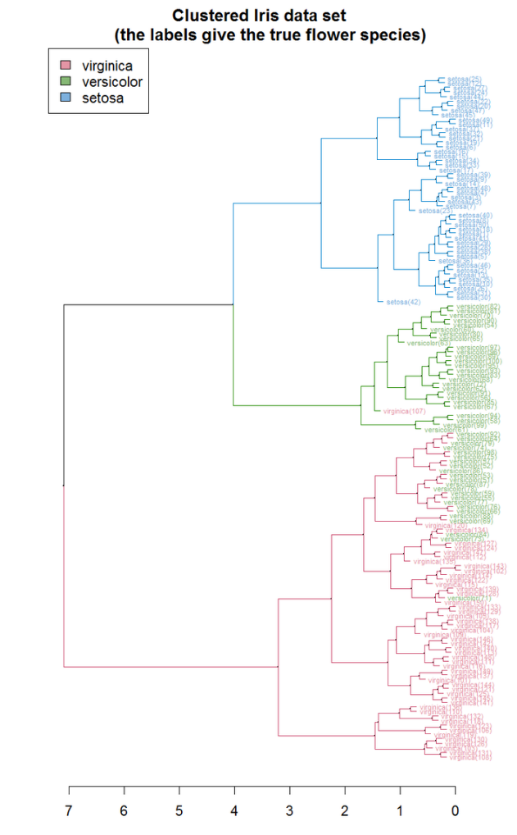
Hierarchical Clustering
Agglomerative hierarchical clustering:
Each observation starts in its own cluster (n clusters if n data points)
Then the distance between each pair of clusters is computed and the 2 closest clusters are combined => n-1 clusters
This is repeated until all the data point fell into 1 single cluster
Divisive hierarchical clustering
Starts will all the points in 1 cluster and iteratively splits the cluster into 2 pieces )
Imsge Credit: https://en.wikipedia.org/wiki/Hierarchical_clustering#/media/File:Iris_dendrogram.png

Slide 14
Hierarchical Clustering
Hierarchical: as the clusters are nested
When 2 clusters are combined, the new cluster can be seen as “above” the previous
Dendrogram is a good tool to visualize the nested structure
NB: the height of the dendrogram shows how far apart the 2 clusters were when they were combined
When doing a hierarchical clustering, you don’t need to know the number of clusters at first
NB: eventually you will still have to optimize it
The dendrogram as well as common sense allow to pick the optimal number of clusters
Imsge Credit: https://en.wikipedia.org/wiki/Hierarchical_clustering#/media/File:Iris_dendrogram.png

Slide 15
Chapter 2: Clustering K-Means Clustering

Slide 16
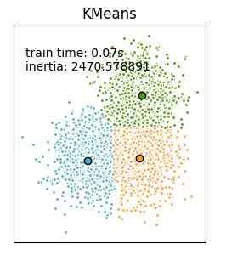
K-means Clustering
K-means clustering is different than hierarchical clustering as it does not form clusters in a hierarchical way
It iteratively re-assigns data points to clusters
Step1: select the desired number of cluster
NB: running first a hierarchical clustering to decide an number of cluster could be useful
Need to tune the number of cluster! Very important
K-means process: once the number of cluster has been selected, each data point is randomly assigned to one of the clusters and each cluster centroid is computed .
Then each data point is reassigned to the closest cluster centroid and the cluster centroids are re-computed
This iterative process Is repeated until no data points need to be re-assigned
Imsge Credit: http://scikit-learn.org/stable/auto_examples/cluster/plot_mini_batch_kmeans.html#sphx-glr-auto-examples-cluster-plot-mini-batch-kmeans-py

Slide 17
K-means Clustering Advantages
Advantages:
Fast algorithm – can even stop when modestly converged and re-start anytime
Works with small and large dataset (not true for hierarchical clustering due to the way of computing distance)
Imsge Credit: http://scikit-learn.org/stable/auto_examples/cluster/plot_mini_batch_kmeans.html#sphx-glr-auto-examples-cluster-plot-mini-batch-kmeans-py

Slide 18
Analyzing Clusters
Each cluster should be analyzed to be described and assess if they are meaningful
Basic statistics in each cluster (min, mean, max, # points)
Feature in common etc …
Heavily dependent on use case
See following Nasdaq use case on clustering visualization and interpretation

Slide 19
Chapter 2: Clustering Application: Document Clustering

Slide 20
T-sne for Clustering Visualization
Nasdaq Data Exploration by Andrew Dotson and Peter Lam, April 2017, Capgemin NAR, Atlanta
Examples/Use Cases
Analyzing Past Data from many different companies
Using K-Means Clustering to Identify Industry Segments
Recommendations based off of K-Means Clusters
Using T-SNE to Further Examine Industry Segments
Insights, and Next Steps

Slide 21
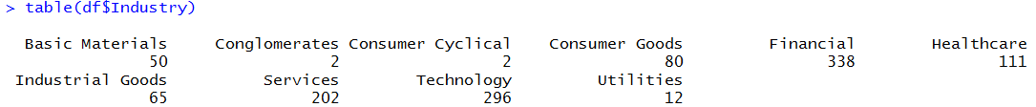
Analyzing Past Data from Many Different Companies
Stock Symbol
Industry
Subindustry
Percent Return per month
Breakdown of Industries
Sources: Andrew Dotson and Peter Lam, April 2017, Capgemin NA, Atlanta
Photos from Google

Slide 22
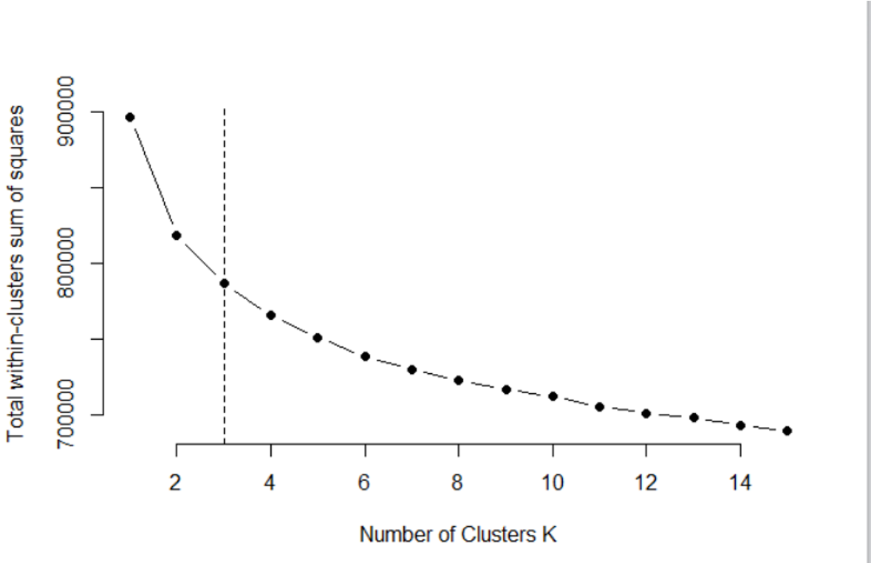
Using K-Means Clustering to Identify Industry Segments
Used Elbow Algorithm to
find Optimal Clusters
Ran a K-Means Clustering
using 3 clusters
Cluster 1 | Cluster 2 | Cluster 3
798 | 90 | 270
Cluster 1 | Financial and Services
Cluster 2 | Technology and Healthcare
Cluster 3 | Technology and Services
Optimal Cluster Size ~3-5. All clusters overlap.
Sources: Andrew Dotson and Peter Lam, April 2017, Capgemin NA, Atlanta

Slide 23
Recommendations based off of K-Mean Clusters
Cluster 1
Stock Symbol | AMED | ISRL | AFAM | MDCA | IDSA
Industry | Healthcare | Basic Material | Healthcare | Healthcare | Services
Cluster 2
Stock Symbol | REGN | ANTP | AMOT | FSYS | ASYS
Industry | Healthcare | Technology | Industry Good | Consumer | Technology
Cluster 3
Stock Symbol | REXMY | DINE | CEDC | JST | CHNR
Industry | Basic Material | Services | Consumer | Technology | Basic Material
Found the top performing stocks over the past 10 years per cluster. Note: Finance is 29% of the data set but is not represented in our model.
Sources: Andrew Dotson and Peter Lam, April 2017, Capgemin NA, Atlanta

Slide 24
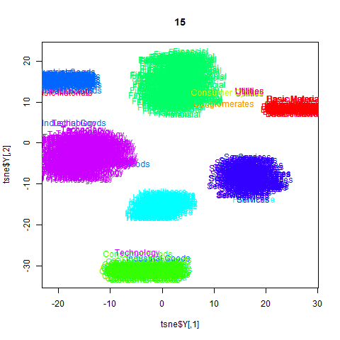
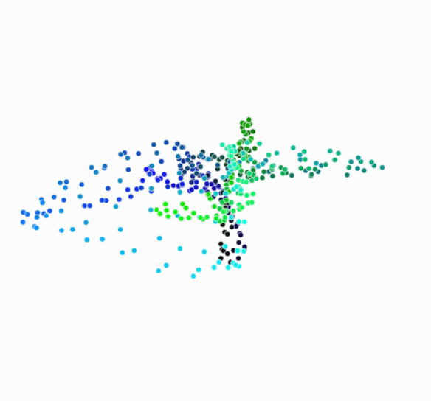
Using T-SNE to Further Examine Industry Segments
T-SNE – t-distributed Stochastic Neighbor Embedding
Useful for visualizing data of two or more dimensions
Constantly adjusts and optimizes the model
T-SNE Graph of Nasdaq Clusters
Legend:
Purple = Technology
Dark Green = Finance
Light Green = Consumer Goods
Darkest Blue = Services
Darker Blue =
Industry Goods
Light Blue = Healthcare
Red = Basic Material
https://distill.pub/2016/misread-tsne/
Able to further segment the industries for future analysis
Sources: Andrew Dotson and Peter Lam, April 2017, Capgemin NA, Atlanta
Notes:
Constantly adjusting and constantly optimizing the model so we can find tangible ___________ from a large dataset.

Slide 25
Insights and Next Steps
Insights
Historically, finance is not the highest performing stock despite being a large volume of the data set.
Financial, Technology, Healthcare, and Services constitute much of the clusters.
Currently, Healthcare, Technology, and Services seem to be the safest industries to invest in.
Next Steps
Further identify industry segments.
Investigate Financial Sector.
Increase volume of data for other sectors because of data imbalance.
Look more in-depth to the subindustries.
Perform linear regressions on all of the industries.
Sources: Andrew Dotson and Peter Lam, April 2017, Capgemin NA, Atlanta

Slide 26
Chapter 2: Clustering Clustering Code Sample

Slide 27
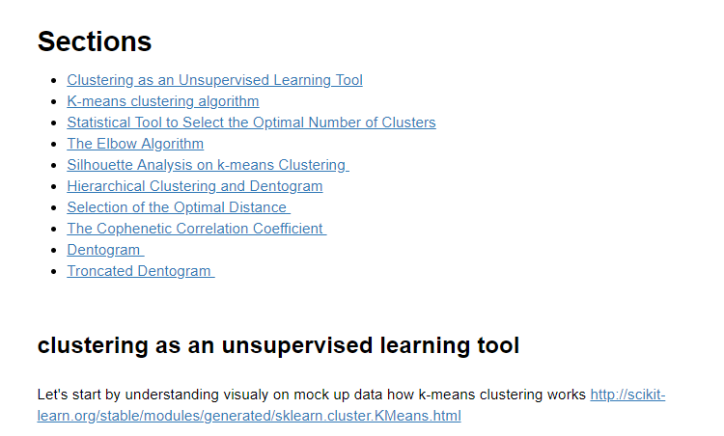
Introduction to the Clustering Algorithm

Slide 28
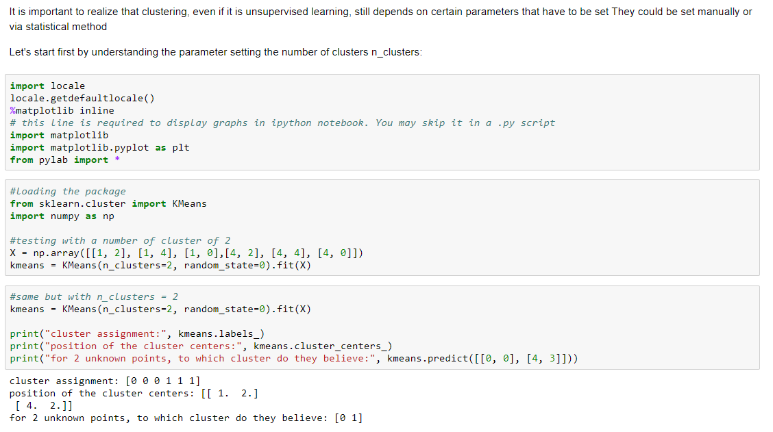
Clustering in a Nutshell

Slide 29
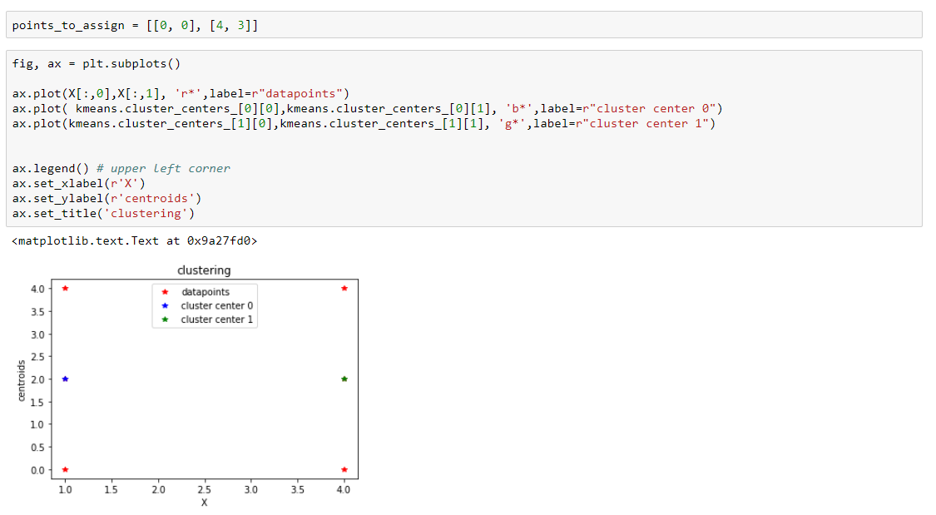
Simplified Visualization

Slide 30
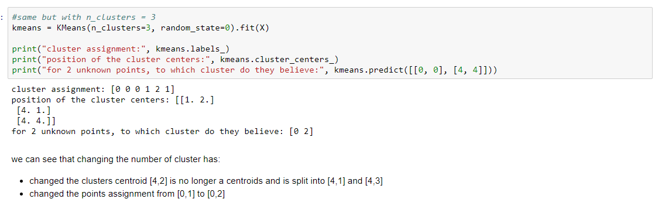
Impact of Clusters Number

Slide 31
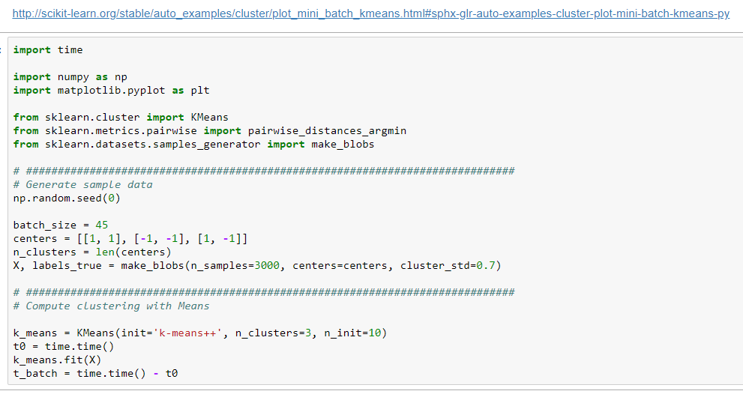
K-mean Clustering Code

Slide 32
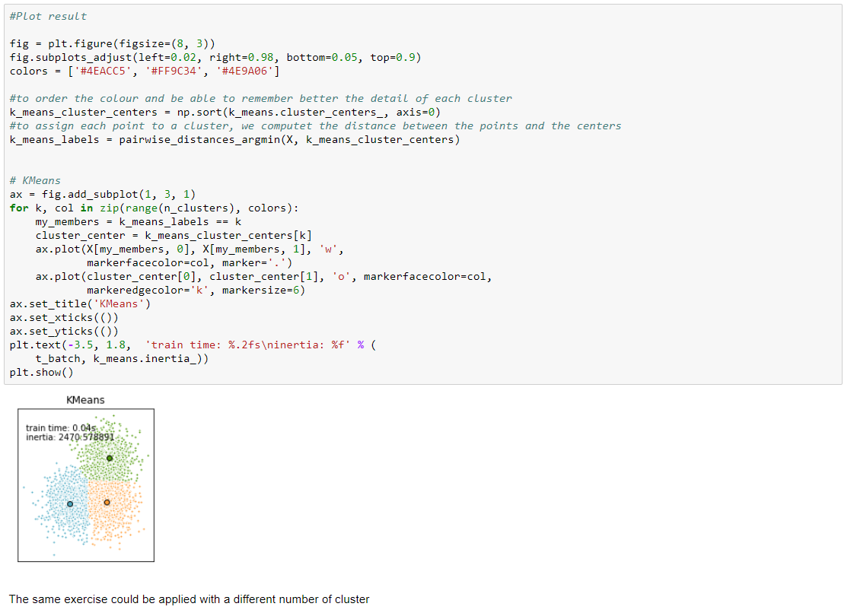
K-mean Visualization
The information contained in this document is proprietary. Copyright © 2018 Capgemini. All rights reserved.

Slide 33
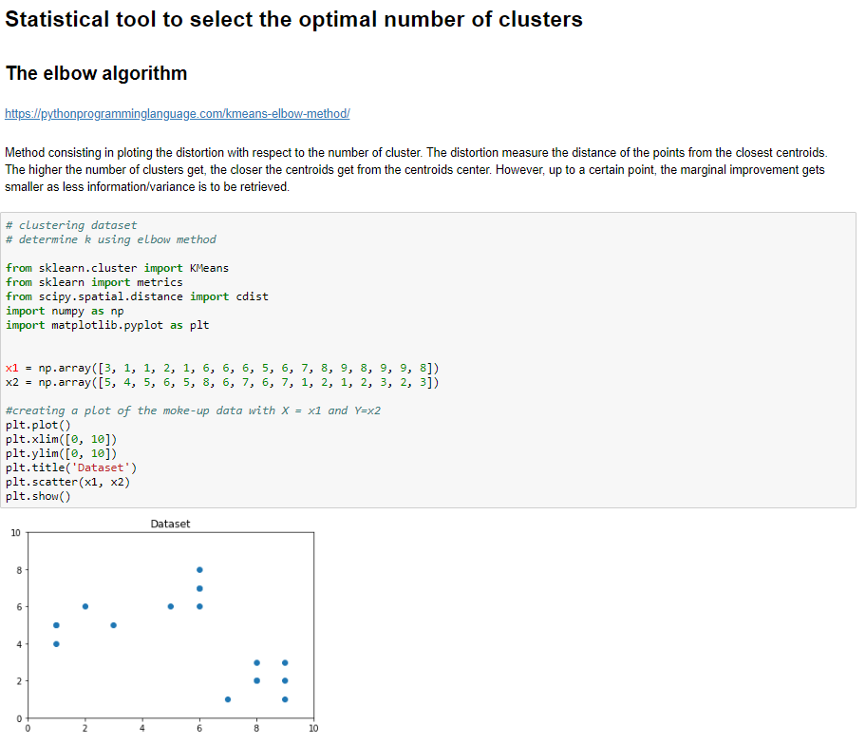
The Elbow Algorithm

Slide 34
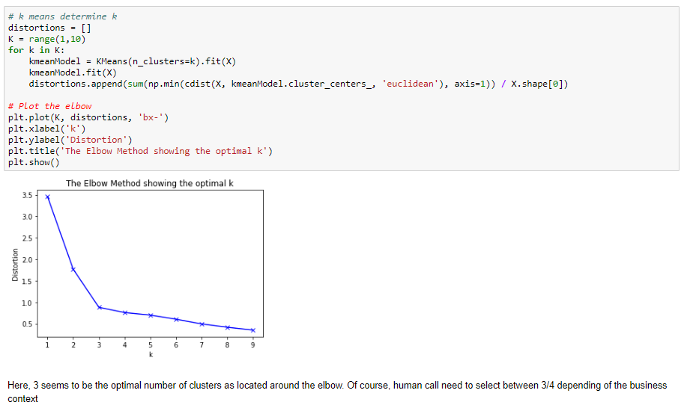
Selecting the Optimal Number of Clusters

Slide 35
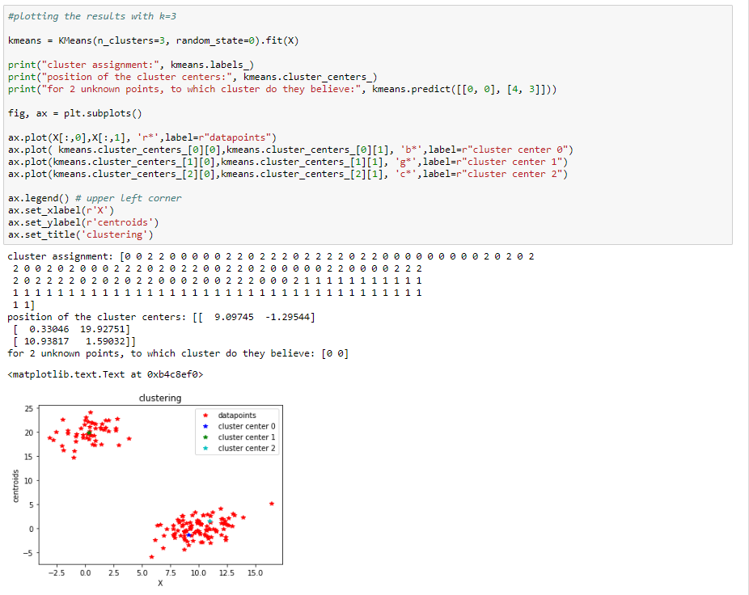
Visualization

Slide 36
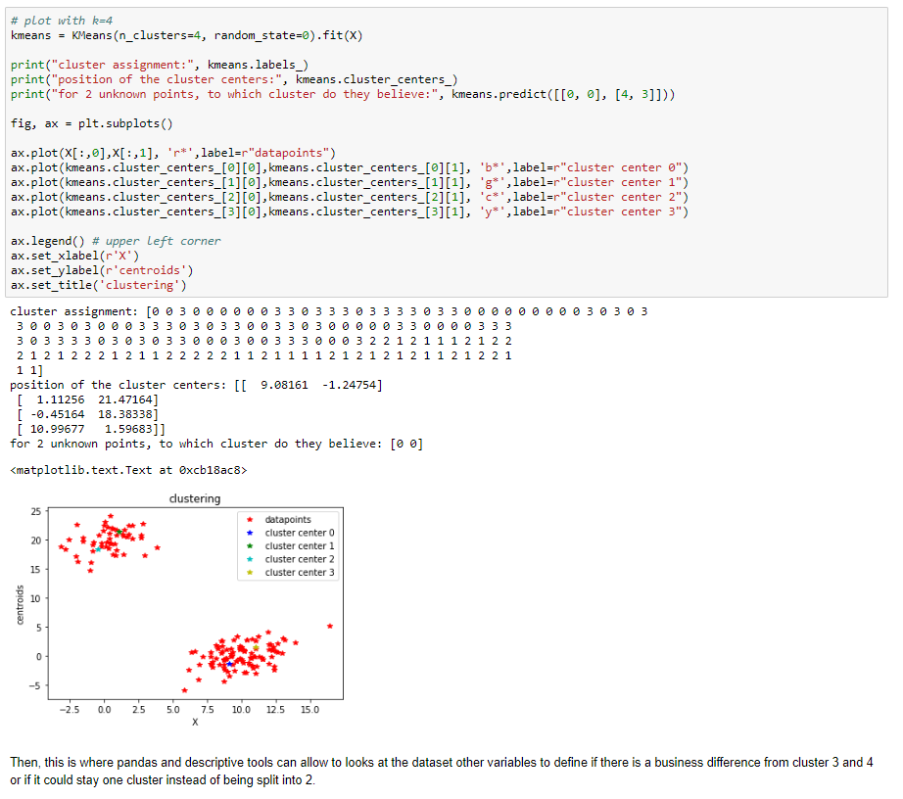
Impact of Clusters Number
The information contained in this document is proprietary. Copyright © 2018 Capgemini. All rights reserved.

Slide 37
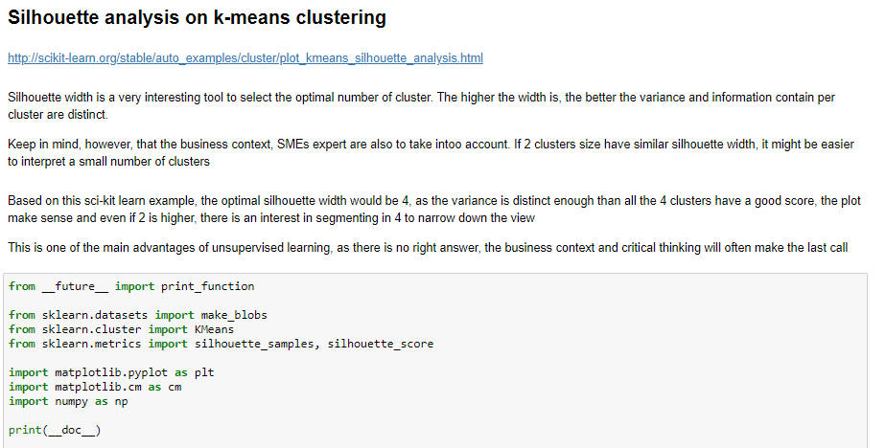
Silhouette Analysis

Slide 38
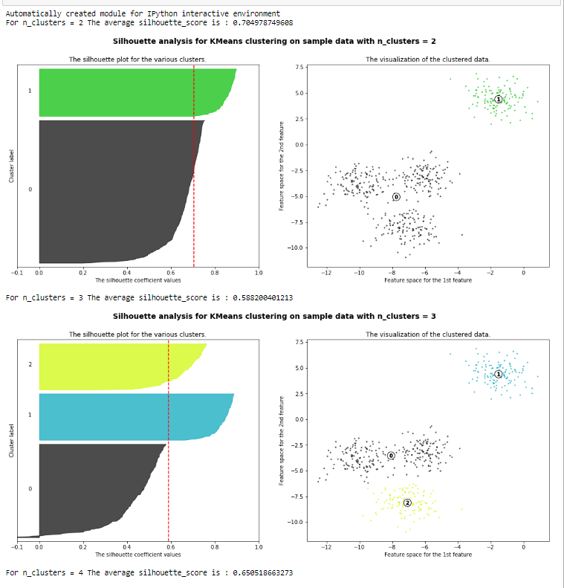
Selecting the Optimal Number of Clusters

Slide 39
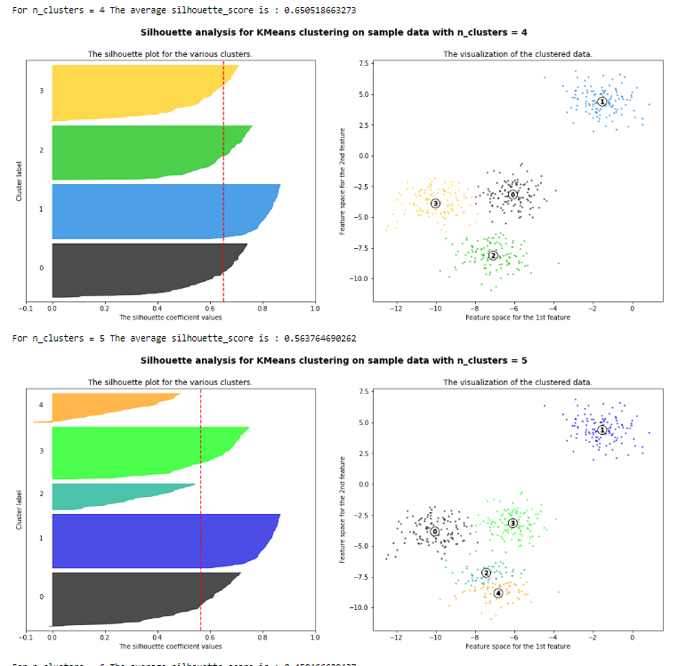
Selecting the Optimal Number of Clusters

Slide 40
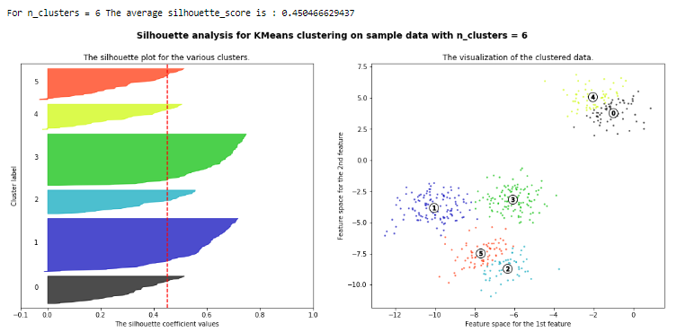
Selecting the Optimal Number of Clusters

Slide 41
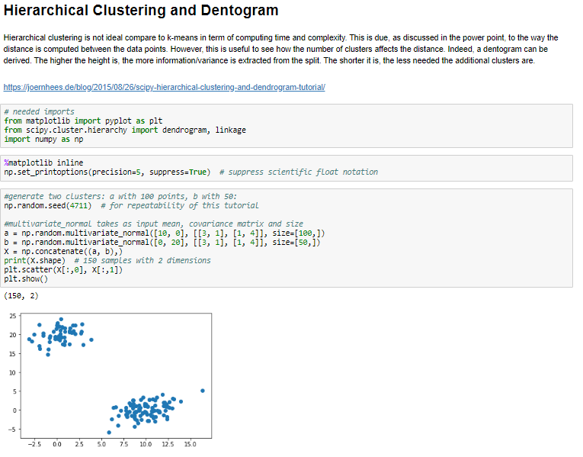
Hierarchical Clustering Code
The information contained in this document is proprietary. Copyright © 2018 Capgemini. All rights reserved.

Slide 42
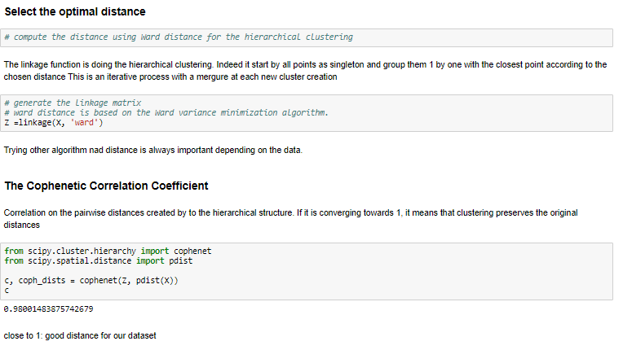
Impact of Distance Type in Clustering

Slide 43
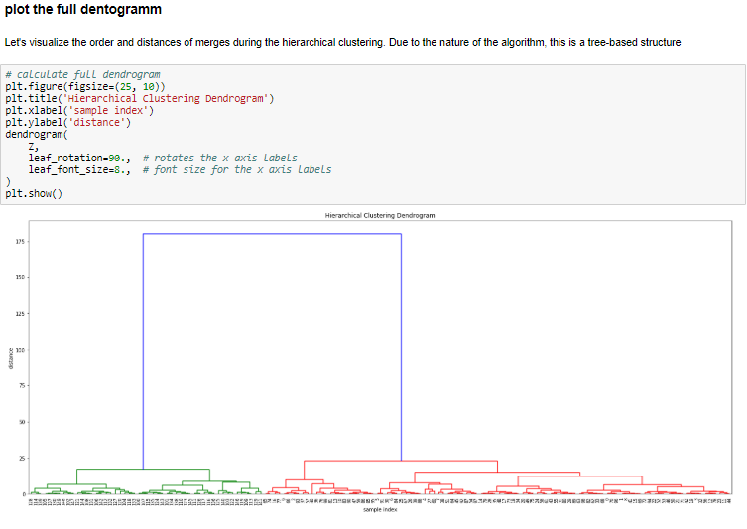
Dentogramm Plot

Slide 44
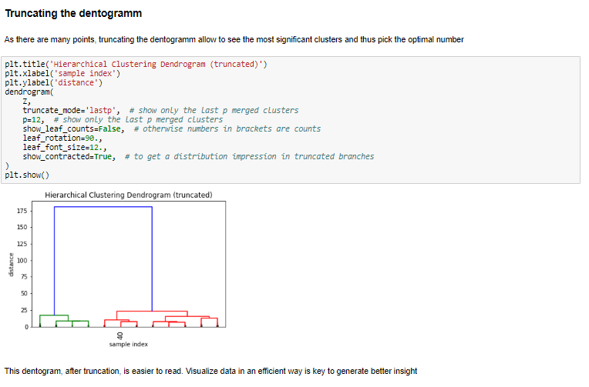
Optimizing Dentogramm Interpretability

Slide 45
Chapter 3: Dimensionality Reduction With PCA (Principal Component
Analysis)

Slide 46
Principal Component Analysis (PCA)
Principle Component Analysis (PCA) is an Unsupervised Means of Dimensionality Reduction
Takes n numeric features from a Data Frame – which might be highly-correlated and simple to understand – and outputs m numeric features (n ≥ m) – which are totally uncorrelated and abstract
Often transforms verbose, high dimensional data (many features) into lower dense, sparse, lower dimensions
Is quiet „expensive“ for Principal Components being derived from Eigenvalues from input data
Any resulting Feature is a Linear Combination of the input Features, which it self is perpendicular to all other resulting Features – hence it is no longer correlated with it
Principal Components are sorted with ascending importance/entropy to your Classification task
Splitting data into respective, distinct train/validation/test sets before applying any task like PCA; otherwise data leakage may lower your performance
In Brief
You lose ease of feature value understanding, do transformations but gain a dense, sparse, lower dimensional dataset with reduced correlation overall

Slide 47
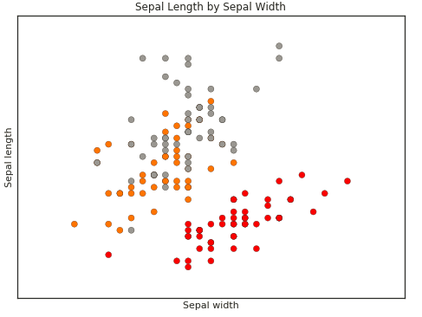
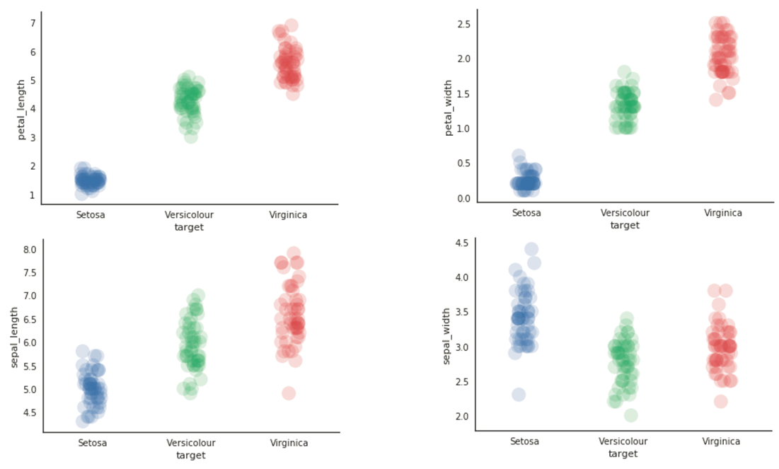
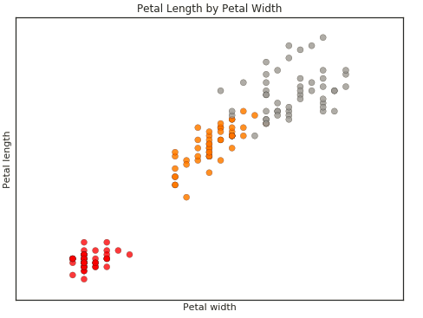
Recap: Discussion
Having Four Features, the iris Data Set is not Trivial to Visualize

Slide 48
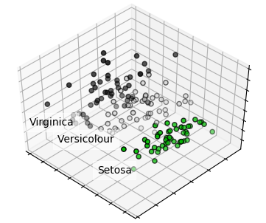
PCA Applied to the iris Data Set
Completely New, Yet Unseen Visualization Due to 3 Principle Components by Classes (T-SNE Even so)
Image courtesy: http://scikit-learn.org/stable/auto_examples/decomposition/plot_pca_iris.html

Slide 49

PCA’s Transformation
PCA Transforms a Given n-Dimensional Feature Space (n=3) into a Lower m -Dimensional Plane (m=2)
Image courtesy: www.analyticsvidhya.com/blog/2016/03/practical-guide-principal-component-analysis-python

Slide 50
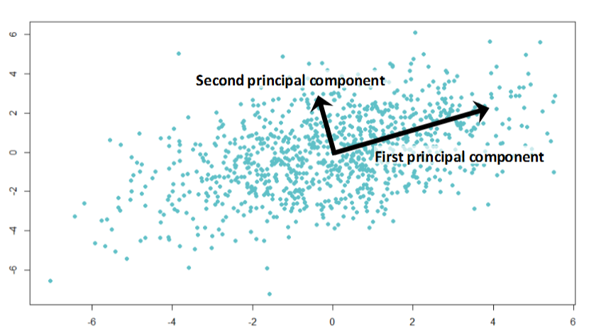
PCA’s Principle Components
All Resulting m Principle Components (PC) are Perpendicular towards another
For a transformation into m Sparser, Denser, Lower Dimensions, there will be m resulting PCs named 1…m
The art & science is, to determine the value for m (a target Feature space of m dimensions)
Image courtesy: www.analyticsvidhya.com/blog/2016/03/practical-guide-principal-component-analysis-python

Slide 51
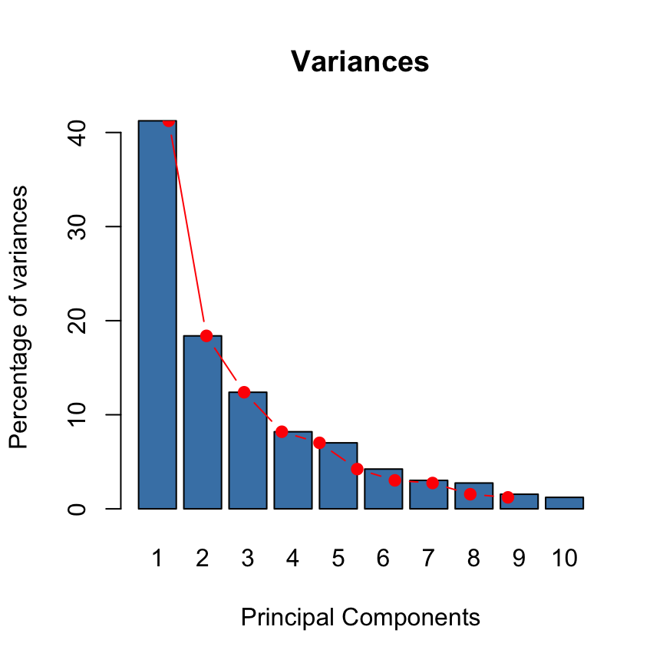
PCA’s Principle Components
All Resulting m Principle Components (PC) are Perpendicular towards another
From one though m, any PC capturing less variance from the data – the first explaining your data more than the second, the second more than the third, etc.
Hence it makes much sense taking PCs 1…k (k < m) as Secondary Features into your Training model
For all PCs being orthogonal to another, you do not mind correlation in between Features any more
From a Variance point of view, it is equivalent to take the 1…k (k < m) first PCs after performing a PCA and to determine the k best predictors through (M)ANOVAs and using them accordingly – the results may differ though
Image courtesy: www.sthda.com/english/wiki/principal-component-analysis-in-r-prcomp-vs-princomp-r-software-and-data-mining

Slide 52
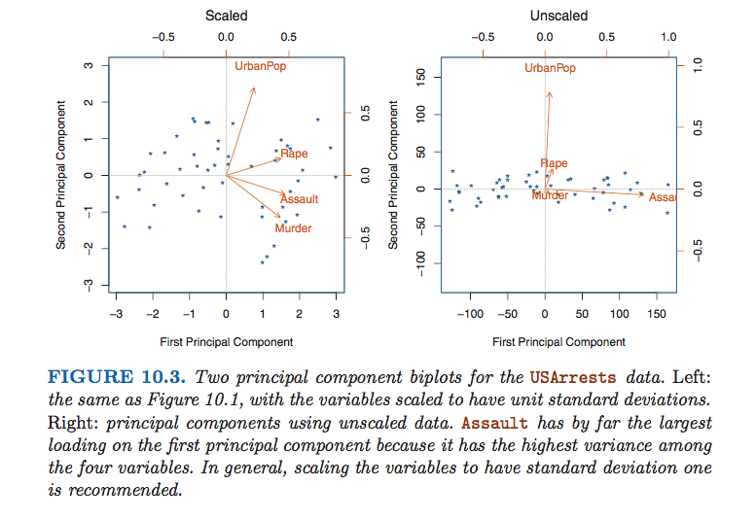
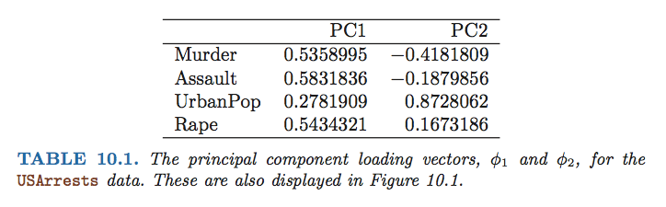
US Arrests Dataset
Image courtesy: Springer Texts in Statistics, An introduction to Statistical Learning – with Applications in R, online pdf

Slide 53
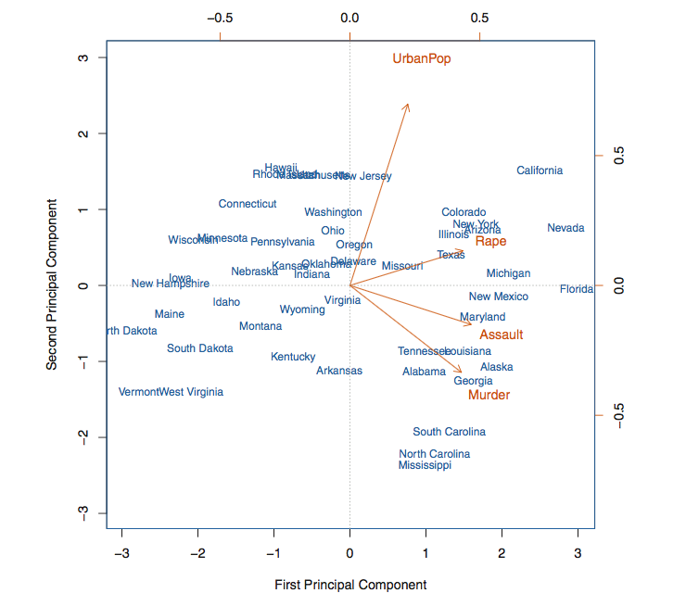
Principal Component Analysis (PCA) as a Tool to Visualize Insights
Image courtesy: Springer Texts in Statistics, An introduction to Statistical Learning – with Applications in R, online pdf

Slide 54
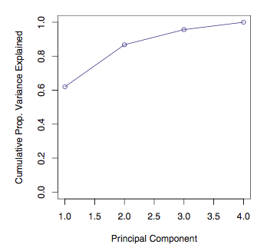
Proportion of Variance Explained
More than 80% of the variance from the dataset is explained by projecting in the plan (PC1;PC2)
Image courtesy: Springer Texts in Statistics, An introduction to Statistical Learning – with Applications in R, online pdf

Slide 55
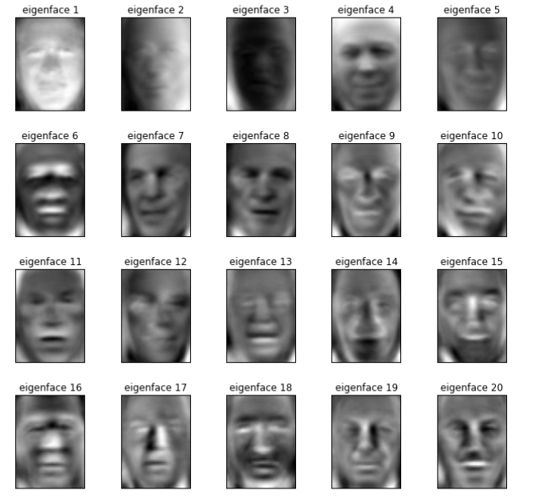
PCA for Images
The first eigenvalues are linked to the first eigenvectors which are no more than the PCA!
Image courtesy: Julie Buard PCA code results using the LFW data: http://vis-www.cs.umass.edu/lfw/

Slide 56
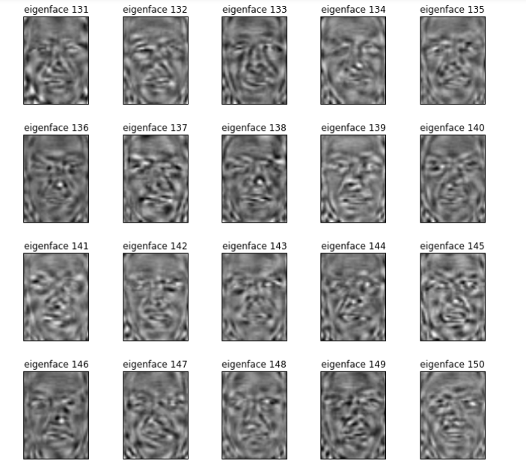
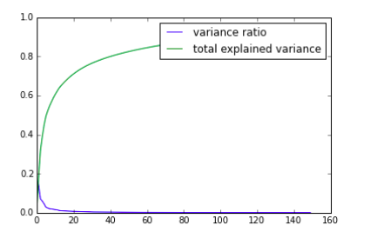
Importance of the Variance Explained
The latest PCA does not provide more information showing how dimentionality reduction is important!
Image courtesy: Julie Buard PCA code results using the LFW data: http://vis-www.cs.umass.edu/lfw/

Slide 57
T-SNE
Spring Example
http://scikit-learn.org/stable/modules/generated/sklearn.manifold.TSNE.html
Tsne process : https://distill.pub/2016/misread-tsne/

Slide 58
Chapter 3: Principal Component Analysis Code Sample

Slide 59
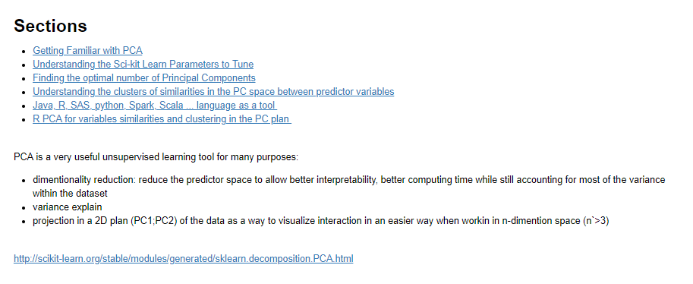
PCA: Introduction to Principal Component Analysis

Slide 60
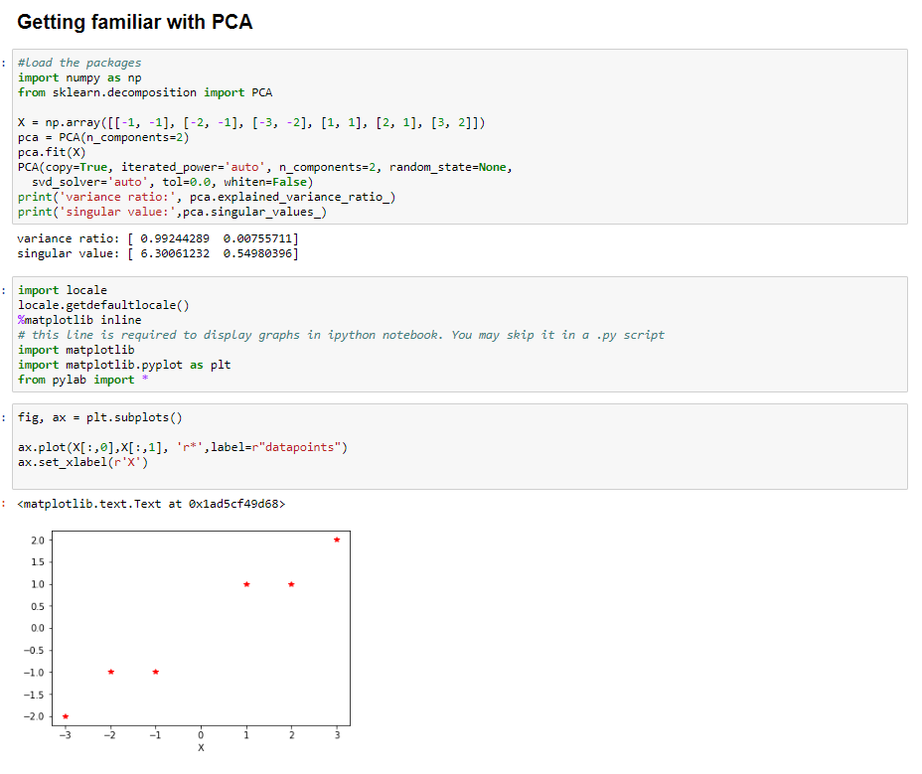
Getting Familiar with PCA
The information contained in this document is proprietary. Copyright © 2018 Capgemini. All rights reserved.

Slide 61
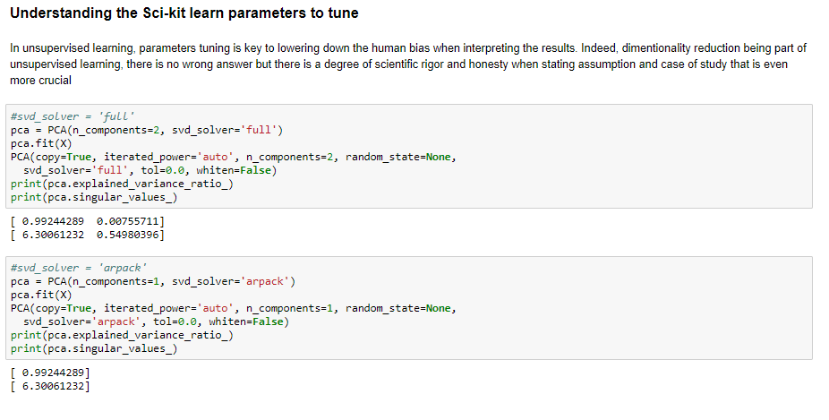
Understanding the Sci-kit Learn Parameters

Slide 62
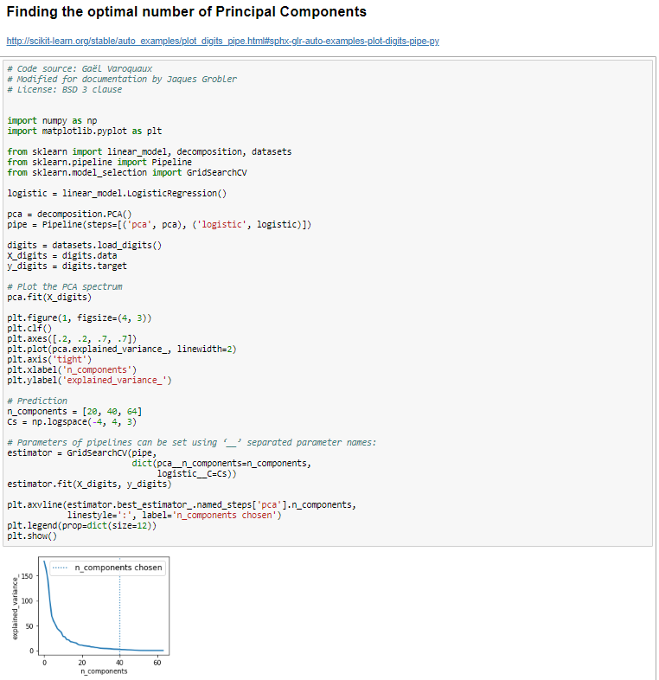
Finding the Optimal Number of Principal Components

Slide 63
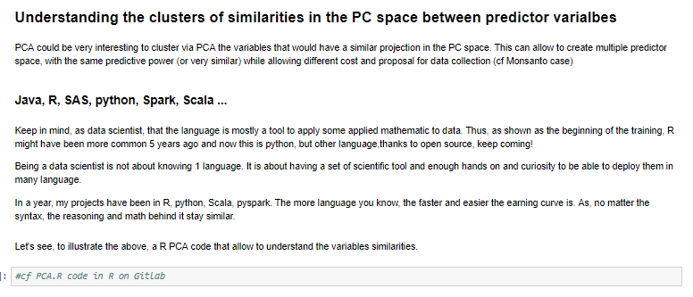
Understanding the Clusters of Similiaries Between Prector Variables in the PC Space

Slide 64
Questions?

Slide 65



- End of Presentation -
Thank you

